Slide 1

Title: Evaluating the Impact of Employee Performance Metrics Across Multiple Variables Using MANOVA.
Shinjon Ghosh
Graduate Student
Department of Mathematics

Slide 2
Background Study
Employee training and development programs are vital for organizations aiming to improve performance, productivity, and engagement across departments.
This study aims to provide a comprehensive view of how several variables influences various performance metrics allowing for targeted improvements.

Slide 3
Dataset
Collect the dataset from Kaggle. The dataset based on “Employee Performance Metrics”.
The dataset have 11 variables( Name, Age, Gender, Projects Completed, Satisfaction Rate%, Feedback Score, Productivity%, Join Date, Department, Position, & Salary) & 200 Observations.
Categorical Data – (Gender, Department, Position)
Discrete Data – ( Projects Completed, Productivity, Satisfaction Rate)
Continuous Data – (Feedback Score)

Slide 4
Goal
• Effect of Gender on Performance Metrics.
• Significant Impact of Department on Performance Metrics.
Significant Effect of Job Position on Performance Metrics.

Slide 5
Main Challenges
Pre-processing the dataset before analysis because there are few missing values and several outliers.
Dataset is not Normal.

Slide 6
Data Pre-Processing
I was formatting the categorical variables (Gender, Department, Position).
Then find out missing or empty values and remove them.

Slide 7
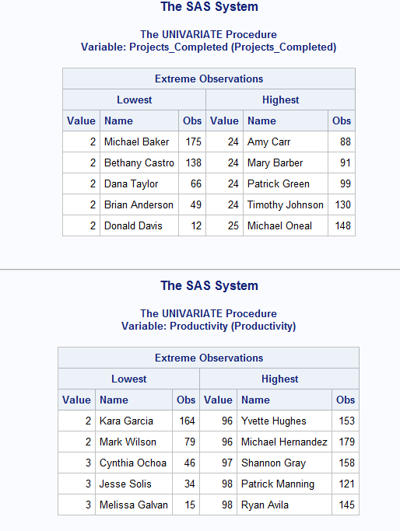
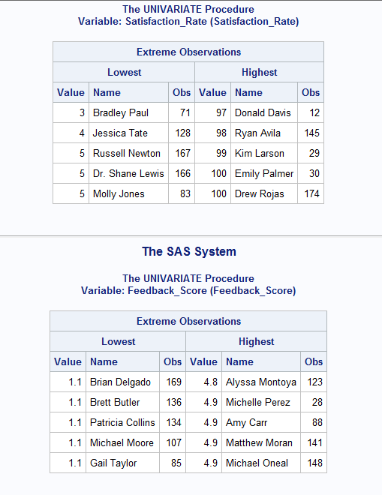
Outlier Test

Slide 8
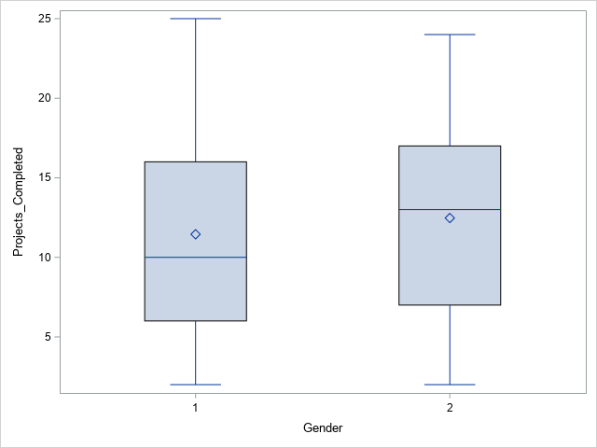
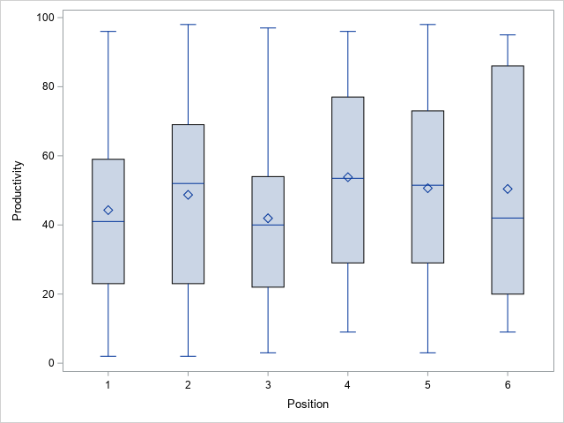
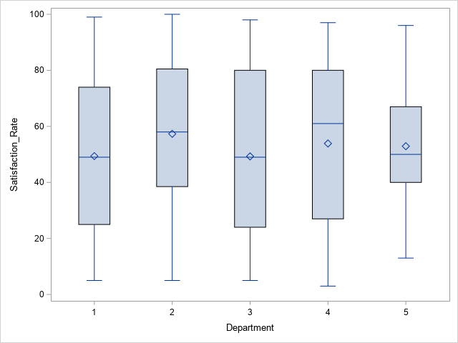
Removing Outlier and Check by Box-Plot

Slide 9
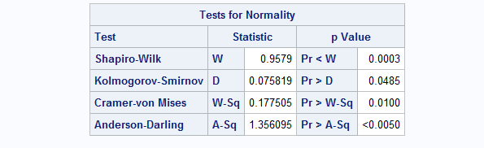
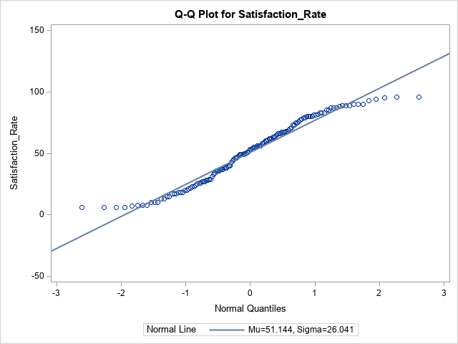
Normality Checking – Performance Metrics

Slide 10
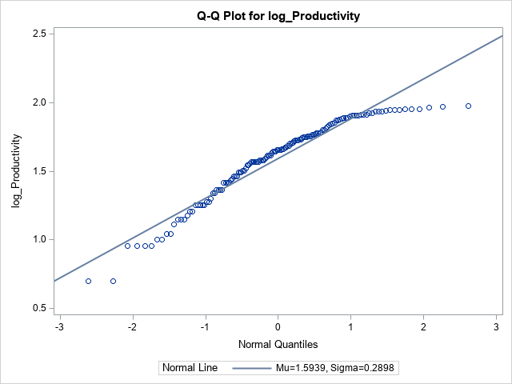
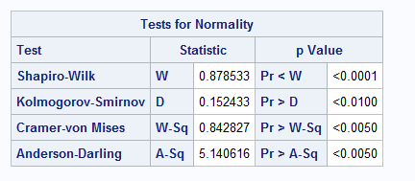
Log Transformation Normality Checking

Slide 11
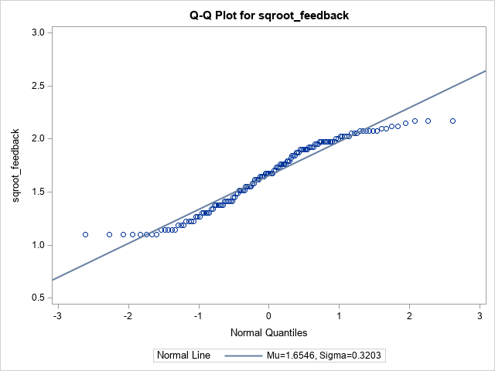
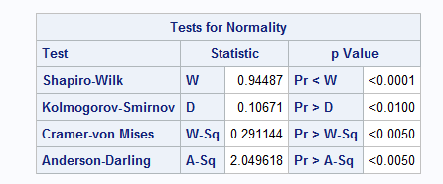
Square Root Transformation Normality Checking

Slide 12
Robust MANOVA
Robust MANOVA refers to modifications of the traditional MANOVA method that make it more resistant or "robust" to violations of its assumptions, particularly normality.
It can handle violations of normality in the data, making it useful for data that is skewed or has outliers.
The most common methods for making MANOVA robust is Bootstrap Resampling which Involves repeatedly sampling from the data to estimate the sampling distribution of the test statistics.
It provides empirical p-values that do not rely on normality assumptions.

Slide 13

Set Hypothesis
$H_{0}$ ​: μ1​ = μ2​ (Gender has no effect on the combination of the dependent variables).
$H_{a}$ ​: μ1​ ≠ μ2​ (Gender has a significant effect on the combination of dependent variables).

Slide 14
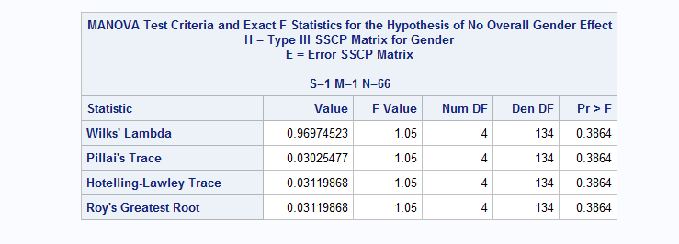
Robust MANOVA

Slide 15
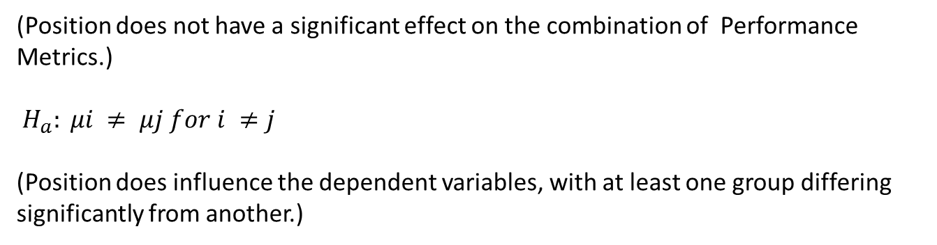

Set Hypothesis
$H_{0}$​: μ1 ​= μ2​ = μ3 ​= μ4 ​= μ5 ​= μ6​
(Position does not have a significant effect on the combination of Performance Metrics.)
$$H_{a}: μi ≠ μj for i ≠j$$
(Position does influence the dependent variables, with at least one group differing significantly from another.)

Slide 16
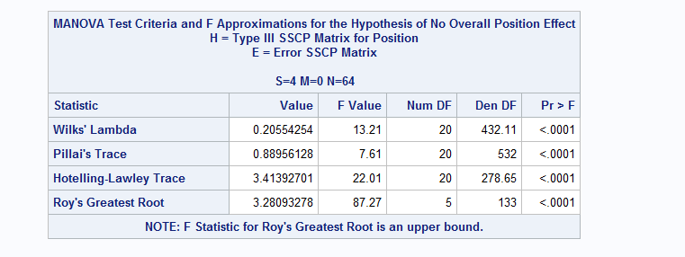
Robust MANOVA

Slide 17
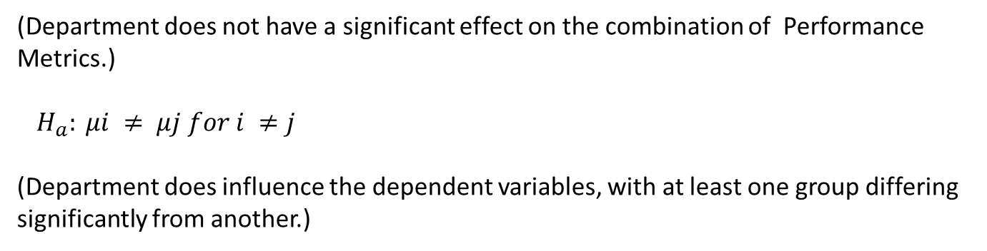

Set Hypothesis
$H_{0}$​: μ1 ​= μ2​ = μ3 ​= μ4 ​= μ5
(Department does not have a significant effect on the combination of Performance Metrics.)
$$H_{a}: μi ≠ μj for i ≠j$$
(Department does influence the dependent variables, with at least one group differing significantly from another.)

Slide 18
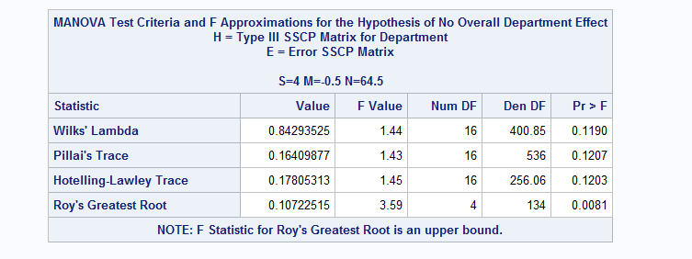
Robust MANOVA

Slide 19
Results
Effect of Gender on Performance Metrics:
We fail to reject Null Hypothesis. Gender has no effect on Performance Metrics.
Effect of Position on Performance Metrics:
We rejected null hypothesis. So, job position has significant impact on Performance Metrics.
Effect of Department on Performance Metrics:
We fail to reject null hypothesis. Thus, department does not have significant effect of Performance Metrics.

Slide 20
Limitations and Further Analysis
Data is not normal. After removing missing values and outliers the total observation is 139.
When null hypothesis rejected, then further analysis (e.g., follow-up ANOVAs or post hoc tests) may be required to determine which specific dependent variables are affected.

Slide 21

Any Questions???

